Slide 1



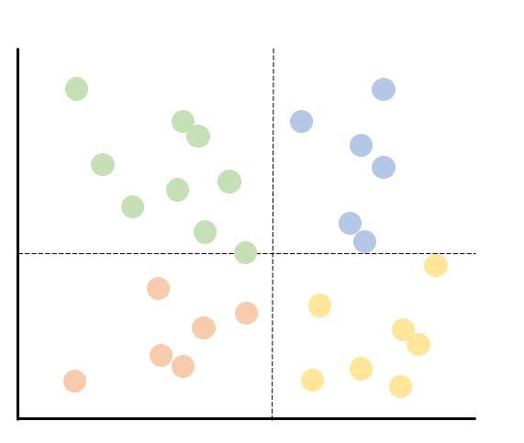
Human
Optimal
Over-corrector
Corrective Feedback
Human
Optimal
Improved
Robot-centric LfD
Learn Personalized Style
Improve Feedback

